Slide 1

歌で学ぶ 日本語
第6週、その1

Slide 2
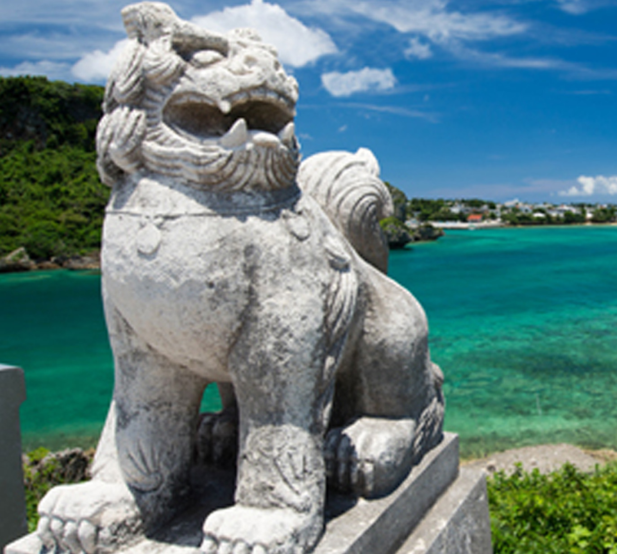
Japan 343: Japanese Language in Society
Online
Course
Take some time this summer to learn about multilingualism in Japan:
The yasashii nihongo movement, which teaches Japanese people how to better communicate with tourists and foreign workers and ^{their families;}
Japan’s languacultures from the Southern languages of Okinawa to the Ainu in the North, and the dialects of the Japanese mainland, including learning about standardization of Japanese and language revitalization;
Japanese Sign Language diversity, education, and Deaf culture;
histories and language education of immigrants to Japan from Korea, Taiwan, China, and Brazil;
Japanese as a second language for “JSL kids” in Japan, including bilingualism and bilingual development, and methods of raising bilingual children.
The course is taught in English. Students from any college are welcome.
Prerequisite: One year of college-level Japanese.

Slide 3
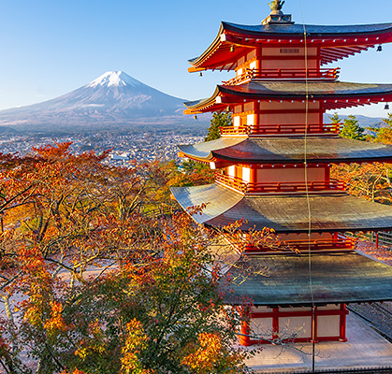
First, Second, and Third-Year Japanese Language Classes!
JAPAN 134 A: First-Year Intensive:
Covers all the chapters of Genki 1 (3rd edition), equivalent of Japan 101-3. 15 credits (VLPA credits if complete the entire course). Offered throughout the summer quarter (9 weeks). Classes meet 8:30am-1pm, M-F. This summer 2021, the course will be offered online. For more information, contact Kaoru Ohta (kaoru@uw.edu).
JAPAN 234 A: Second-Year Intensive:
Equivalent of JAPAN 201, JAPAN 202, JAPAN 203. Satisfies requirements for entry to JAPAN 301, but recommended primarily for those going to Japan shortly upon completion.
JAPAN 334 A: Third-Year Intensive:
Equivalent to JAPAN 301, JAPAN 302, and JAPAN 303.

Slide 4
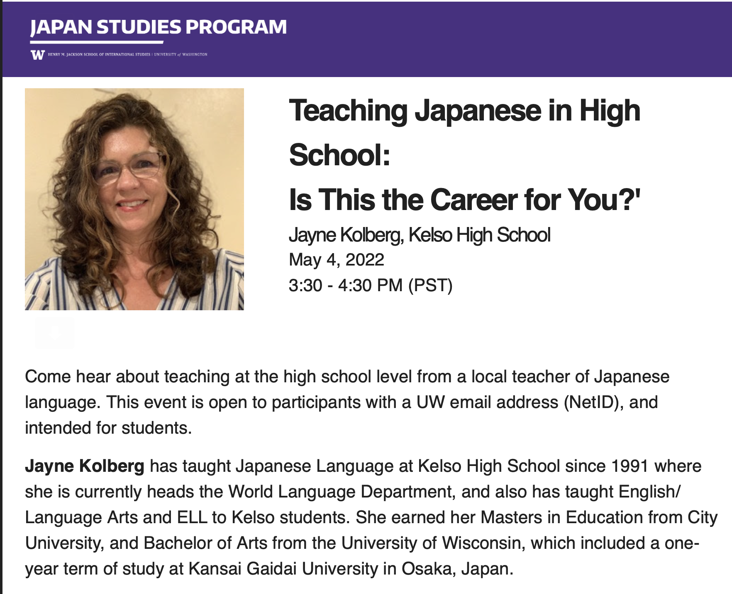
https://washington.zoom.us/my/aohta
Guest Lecture in Japan 344 Wednesday.
All UW Students are welcome!
https://washington.zoom.us/my/aohta
Notes:
Amy Snyder Ohta is inviting you to a scheduled Zoom meeting.
Topic: Amy's Winter quarter classes
Time: This is a recurring meeting Meet anytime
Join Zoom Meeting
https://washington.zoom.us/j/91617852059
Meeting ID: 916 1785 2059
One tap mobile
+12532158782,,91617852059# US (Tacoma)
+12063379723,,91617852059# US (Seattle)
Dial by your location
+1 253 215 8782 US (Tacoma)
+1 206 337 9723 US (Seattle)
+1 346 248 7799 US (Houston)
+1 602 753 0140 US (Phoenix)
+1 669 219 2599 US (San Jose)
+1 669 900 6833 US (San Jose)
+1 720 928 9299 US (Denver)
+1 971 247 1195 US (Portland)
+1 213 338 8477 US (Los Angeles)
+1 301 715 8592 US (Washington DC)
+1 312 626 6799 US (Chicago)
+1 470 250 9358 US (Atlanta)
+1 470 381 2552 US (Atlanta)
+1 646 518 9805 US (New York)
+1 646 876 9923 US (New York)
+1 651 372 8299 US (Minnesota)
+1 786 635 1003 US (Miami)
+1 267 831 0333 US (Philadelphia)
Meeting ID: 916 1785 2059
Find your local number: https://washington.zoom.us/u/aciBGQPrqp
Join by SIP
91617852059@zoomcrc.com
Join by H.323
162.255.37.11 (US West)
162.255.36.11 (US East)
221.122.88.195 (China)
115.114.131.7 (India Mumbai)
115.114.115.7 (India Hyderabad)
213.19.144.110 (Amsterdam Netherlands)
213.244.140.110 (Germany)
103.122.166.55 (Australia Sydney)
103.122.167.55 (Australia Melbourne)
209.9.211.110 (Hong Kong SAR)
149.137.40.110 (Singapore)
64.211.144.160 (Brazil)
69.174.57.160 (Canada Toronto)
65.39.152.160 (Canada Vancouver)
207.226.132.110 (Japan Tokyo)
149.137.24.110 (Japan Osaka)
Meeting ID: 916 1785 2059

Slide 5
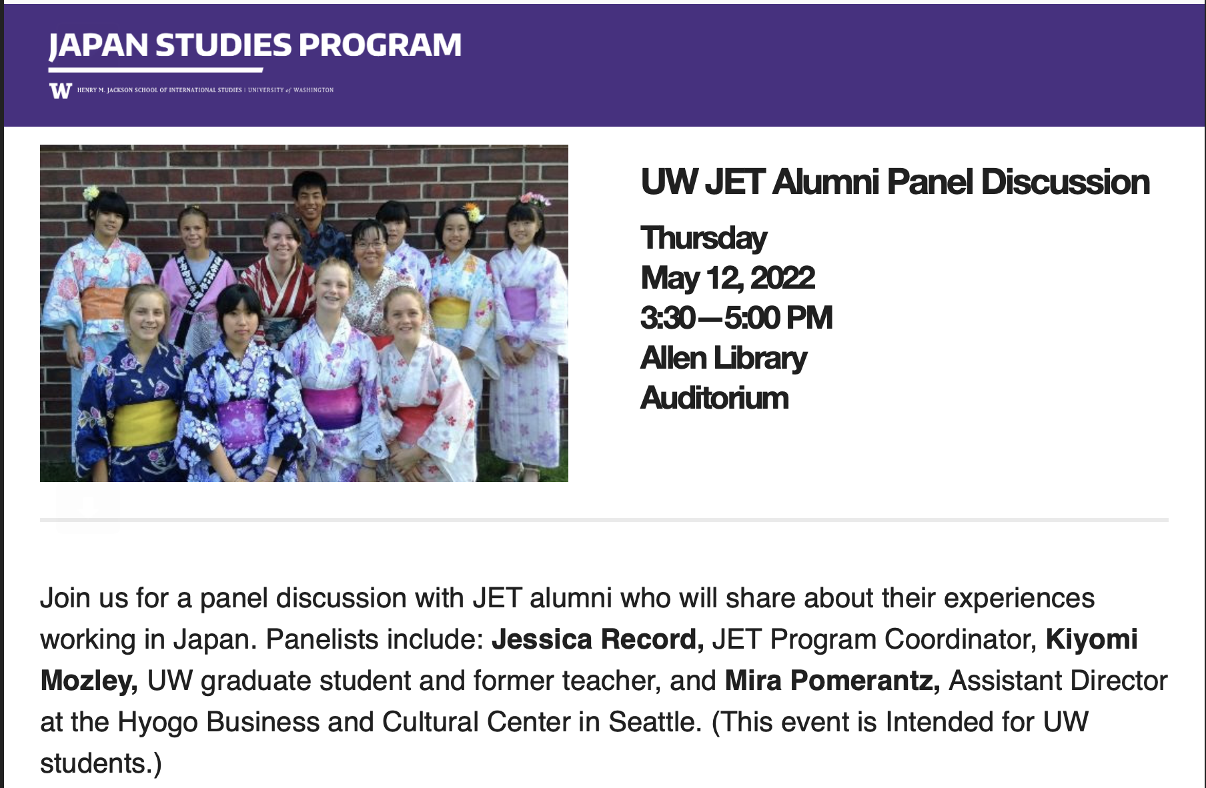
Notes:
Amy Snyder Ohta is inviting you to a scheduled Zoom meeting.
Topic: Amy's Winter quarter classes
Time: This is a recurring meeting Meet anytime
Join Zoom Meeting
https://washington.zoom.us/j/91617852059
Meeting ID: 916 1785 2059
One tap mobile
+12532158782,,91617852059# US (Tacoma)
+12063379723,,91617852059# US (Seattle)
Dial by your location
+1 253 215 8782 US (Tacoma)
+1 206 337 9723 US (Seattle)
+1 346 248 7799 US (Houston)
+1 602 753 0140 US (Phoenix)
+1 669 219 2599 US (San Jose)
+1 669 900 6833 US (San Jose)
+1 720 928 9299 US (Denver)
+1 971 247 1195 US (Portland)
+1 213 338 8477 US (Los Angeles)
+1 301 715 8592 US (Washington DC)
+1 312 626 6799 US (Chicago)
+1 470 250 9358 US (Atlanta)
+1 470 381 2552 US (Atlanta)
+1 646 518 9805 US (New York)
+1 646 876 9923 US (New York)
+1 651 372 8299 US (Minnesota)
+1 786 635 1003 US (Miami)
+1 267 831 0333 US (Philadelphia)
Meeting ID: 916 1785 2059
Find your local number: https://washington.zoom.us/u/aciBGQPrqp
Join by SIP
91617852059@zoomcrc.com
Join by H.323
162.255.37.11 (US West)
162.255.36.11 (US East)
221.122.88.195 (China)
115.114.131.7 (India Mumbai)
115.114.115.7 (India Hyderabad)
213.19.144.110 (Amsterdam Netherlands)
213.244.140.110 (Germany)
103.122.166.55 (Australia Sydney)
103.122.167.55 (Australia Melbourne)
209.9.211.110 (Hong Kong SAR)
149.137.40.110 (Singapore)
64.211.144.160 (Brazil)
69.174.57.160 (Canada Toronto)
65.39.152.160 (Canada Vancouver)
207.226.132.110 (Japan Tokyo)
149.137.24.110 (Japan Osaka)
Meeting ID: 916 1785 2059

Slide 6

ベルベットイースター
荒井由美
あら い ゆ み

Slide 7

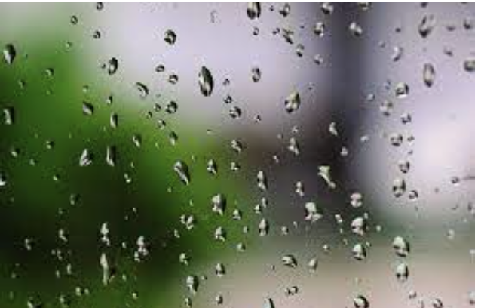
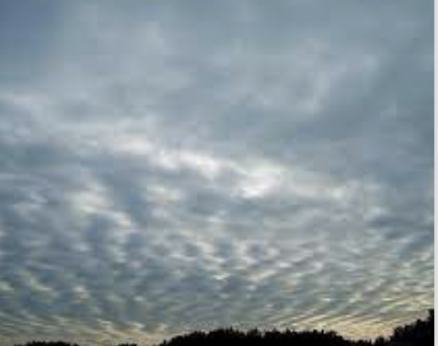


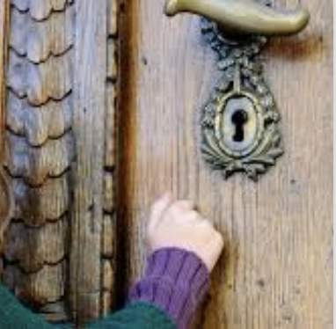
ベルベット・イースター
このイメージの思い出がありますか？話してください。
小雨？
窓にいっぱい、光るしずく？
まだ眠い時に親戚のドアをたたく？
天使が降りて来そうほどの低い空？
一番好きな季節？
いつもと違う日曜日？
帽子（または、何か）を花でかざる？
ママが好きだったくつをはいた？

Slide 8

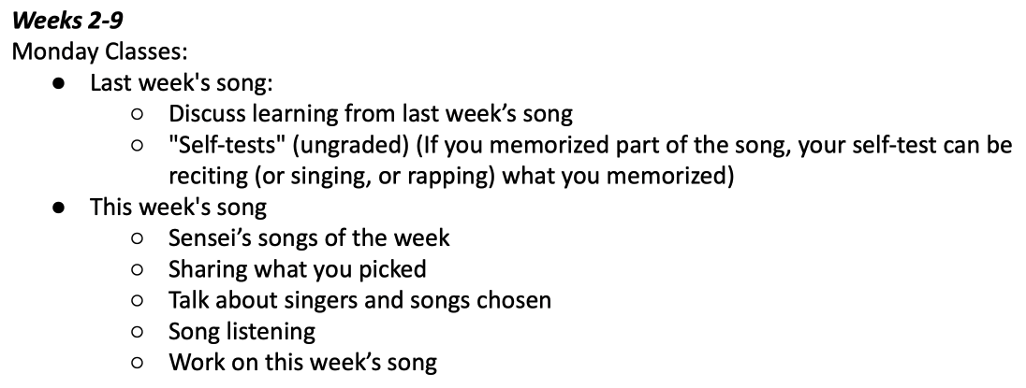
今日の授業のスケジュール
Remember to include
クラスでの会話のために

Slide 9
